Slide 1


City of Hartford HUD Programs:
Community Development Block Grants (CDBG), Housing Opportunities for persons with HIV/AIDS (HOPWA) Emergency Solutions Grant (ESG)
PUBLIC HEARING & TECHNICAL ASSISTANCE SESSION FISCAL YEAR 2026-2027
Session
ZOOM
TUESDAY, FEBRUARY 10, 2026 – 12:30 PM

Slide 2
Agenda
Welcome & Introductions
HUD Funding Overview
Applicants/Eligible Entities
Application Changes: This year vs last year
2026-27 CDBG, HOPWA & ESG Applications
Program Operation – Required Forms
Questions
2

Slide 3
HUD Funding Overview
The City of Hartford is funded annually by the U.S. Department of Housing and Urban Development (HUD) to support its mission to strengthen Hartford and its residents. The City seeks applications from local agencies who provide critical services and programs. Using a competitive process, successful applications are funded for the most needed, effective, and compliant programs.
Community Development Block Grant - CDBG
Housing Opportunities for Persons Living with AIDS - HOPWA
Emergency Solutions Grant - ESG
Home Investment Partnerships Program - HOME
3
Notes:
The HOME program is run through Dept. of Dev Services and monies are distributed by them
The three programs run by Central Grants have an RFP process whereby grants are competitively awarded to sub-recipients for worthy projects

Slide 4
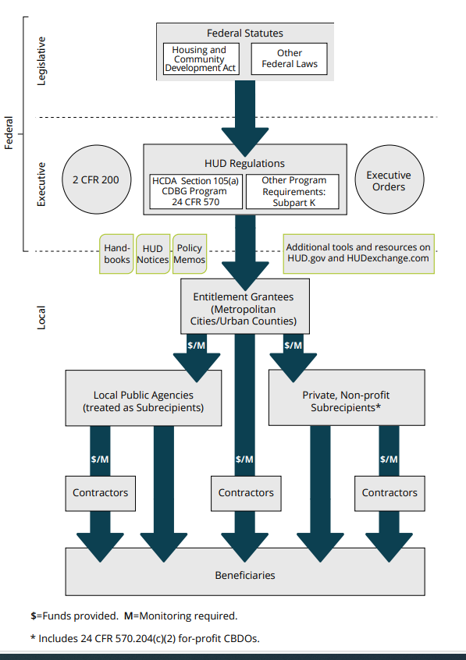

HUD PROGRAMS REGULATORY FRAMEWORK
Notes:
Remember to upload- HUD is a rule driven Fed agency – it is comprehensive around housing- we are given funds to improve the city but only if we abide by rules. This is a comprehensive document–note how the Fed laws guide all actions and allocations – Monitoring is required

Slide 5
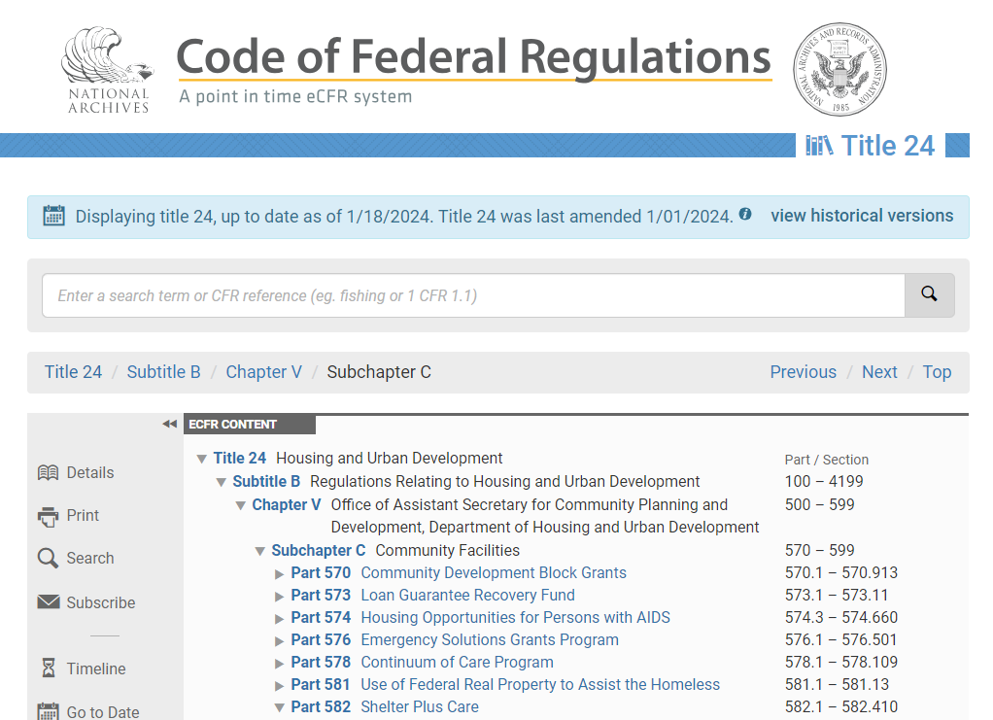



https://www.ecfr.gov/
5
Notes:
All Government programs are guided by a set of Federal Regulations that are found online at this website. – Should you have questions – this should be one of your first stops.

Slide 6
Community Development Block Grant (CDBG)
CDBG Entitlement Program- annual grants to local governments principally for low-and moderate-income persons to address community development needs:
Decent, affordable housing by revitalizing neighborhoods
Viable urban development through expansion and improvement of quality community services
Economic development by expanding and retaining businesses and creating and retaining jobs
U.S.C. Title 42 - THE PUBLIC HEALTH AND WELFARE (govinfo.gov)
eCFR :: 24 CFR Part 570 -- Community Development Block Grants
6
Notes:
Goals divided into three buckets-
housing and neighborhoods- infrastructure and repairs-
Public Service– 15% of allocation
Economic Development growing businesses and jobs

Slide 7
Housing Opportunities for Persons with AIDS (HOPWA)
The HOPWA program provides housing assistance and related supportive services for low-income persons living with HIV/AIDS and their families. The application is on the website and regulations are referenced. eCFR :: 24 CFR Part 574 -- Housing Opportunities for Persons with AIDS
Emergency Solutions Grant (ESG)
The ESG program assists individuals and families to quickly regain stability in permanent housing after experiencing a housing crisis or homelessness. The application is on the website and regulations are referenced eCFR :: 24 CFR Part 576 -- Emergency Solutions Grants Program.
Home Investment Partnerships Program (HOME)
HOME funds a wide range of activities and provides incentives to for-profit and nonprofit developers to build, buy, and/or rehabilitate affordable housing for rent or homeownership to low-income people. These funds are managed by the Housing Division of the City’s Department of Development Services. eCFR :: 24 CFR Part 92 -- Home Investment Partnerships Program
For more information regarding HOPWA and ESG and HOME Grants please refer to Federal Grants – City of Hartford (hartfordct.gov)
7

Slide 8
Eligible Applicants: Basic Criteria
Community-based organizations serving low- and moderate-income Hartford residents
Have a 501(c)(3) designation from the IRS at the time of application
Incorporated with the Secretary of State
Have a SAM UEI at the time of application (sam.gov).
8
Notes:
Start now if you don’t have a UEI- this is required – time limited – technically you cannot be reimbursed without this – it will take time. Begin the process- If you subcontract you must require this from all subcontractors as well.

Slide 9
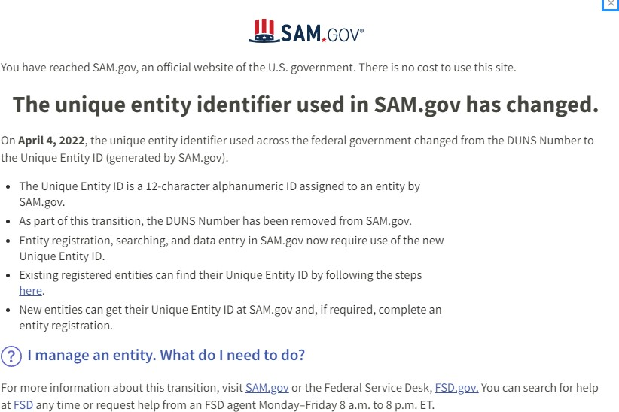
CDBG Application Process
Section 1 Organization Contact Information
SAM.gov | Home
The Federal Government is no longer using DUNS #.
SAM, is an alternative - Unique Entity Identifiers (UEI). Your organization should register. It is required.
Use N/A for fields that don’t apply like if you don’t have a website
NOTE: Subcontractors, must also have a valid UEI and be vetted

Slide 10
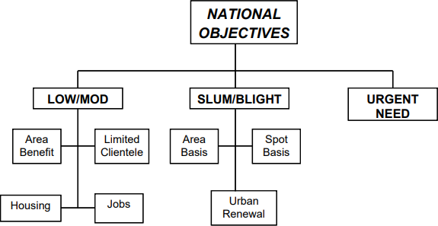
Eligibility Criteria: Meets a National Objective
The proposed project:
Meets a HUD National Objective included in Hartford’s current Consolidated Plan (FY2020-25)*
Serves Hartford’s High Priority Community Development Needs and Goals
* Federal Grants – City of Hartford (hartfordct.gov).
8
Notes:
National Objectives definition - we focus on Low Mod Income objectives- 4 ways that this can be met depending on the type of activity that you are proposing.
Area Benefit- everyone in a location can use the service, or would benefit from the activity– e.g. CT river parks Bushnell Park, Mental Health Provider
Limited Clientele- focus on a sector or group – a particular school , or recreation center \
Jobs- the proprietor or the staff is LMI

Slide 11
CDBG: Low-Mod Income Beneficiaries
Low/Mod Income Area Benefit Activity (LMA)
  benefits open to all the residents in a particular geographical area
  > 51% of the residents are low- and moderate-income persons (using HUD income guidelines for low- and moderate-incomes by household size).
Low/Mod Income Limited Clientele Activity (LMC)
  benefits a limited clientele,
  > 51% are low- and moderate-income persons.
  presumed to be principally low- and moderate-income (e.g abused children; elderly persons; illiterate adults; migrant farm workers)
Low/Mod Income Job Creation or Retention Activity (LMJ)
  designed to create or retain permanent jobs,
  > 51% of jobs (FTJE) employ/turnover to low- and moderate-income persons.
  If job is in 20% poverty census track- it is presumed to be low Income
Notes:
How do you determine which one is appropriate

Slide 12
CDBG: Eligible vs. Ineligible Activities
Eligible activities vary depending on the category of national objective and the corresponding matrix code.
Ineligible activities include, but are not limited to: purchase of equipment, operating and maintenance expense, unrestricted funds, political activities, lobbying, insurance costs, and income payments.
Notes:
The matrix codes and National Objectives are complex. We don’t use all of them and we do a lot of the coding internally to facilitate the decision making and - it is called HUDSPEAK and we try to minimize the confusion

Slide 13
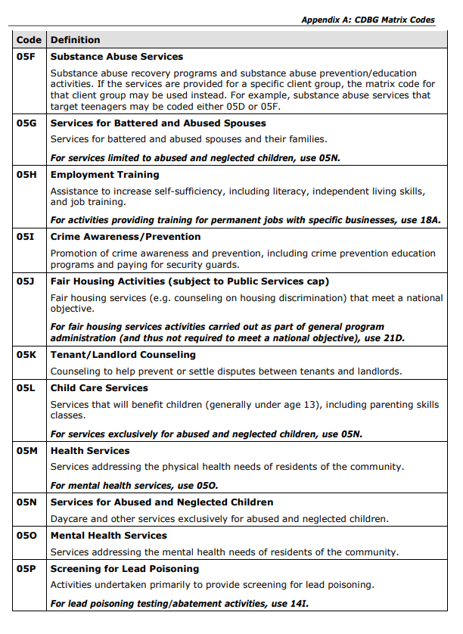
CDBG Matrix Coding
Each project receives a code that defines the funded activity.
Not all activities are appropriate for certain National Objectives
Depending on the combination of the matrix code and National objective, HUD requires certain information be collected

Slide 14
National Objectives possible for CDBG activities
LMC
Childcare Services
Sexual Assault Services
LMC
Microenterprise Assist
Economic Development TA
LMA
LMJ
LMC
Mental Health Services
Employment Training
LMA
Notes:
Cost of the program can influence which type of national objective is chosen.

Slide 15
CDBG, HOPWA, ESG Application Overview:
All application materials including instructions are available at:
Central Grants Administration – City of Hartford (hartfordct.gov) within FY26-27
CDBG - ESG- HOPWA Application Process
Please review the application in advance of the submission deadline. A PDF of the applications (Sample Application) are available on the website within“support for the applications”
Required forms are available in the HUD FORMS section. Most are fillable and can be uploaded into the application when requested. The budget template is accessed from within the application or in the application section.

Slide 16
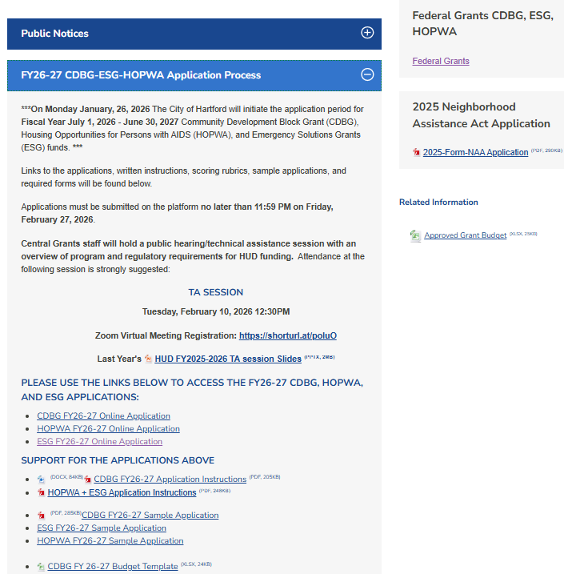

Application Overview: Accessing the Applications
Other HUD information
Application links on Website
Instructions
and
Sample Applications

Slide 17
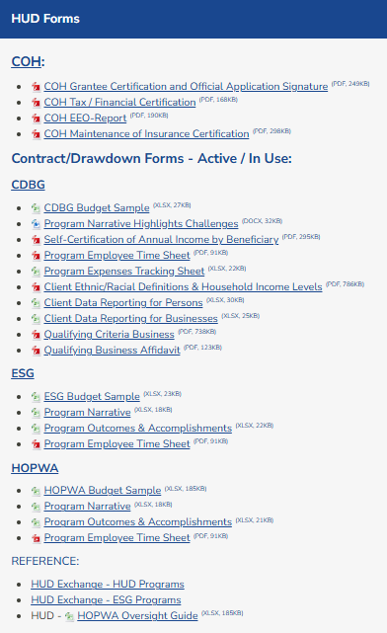
Application Overview: Accessing related documents for program use
HUD downloadable forms for use with financial and accomplishment reporting

Slide 18
The same as last Year
All programs use OPENFORMS found on the City’s website and accessed with a link.
Requests for Public Service funding should be modest as the funding is limited in this category.
City requirements have not changed.
You can save and return to incomplete applications
Some upload documents are on the Central Grants website
18

Slide 19
Changes from last year- All applications
There are new questions in the application- allow adequate time to submit before the deadline.
Some question formats have been modified –read the questions carefully
Some questions require detailed responses, be intentional and concise (characters are limited) Your response may be used as contract language
A few questions are not “required” but need an answer
As a result of recent federal executive orders some HUD requirements have changed and are stricter
19

Slide 20
Changes from last year- CDBG
For organizations with prior CDBG funding, compliance and risk will be assessed using existent performance data.
Applicants with new programs will be able to provide planning data if no operational data is available.
The budget form includes administrative/indirect costs. CDBG programs are asked to keep administrative costs at or below 10%.
20

Slide 21
Changes from last year- HOPWA
The service area is the Eligible Metropolitan Statistical Area,– (EMSA) – and includes Hartford, Middlesex, and Tolland Counties;
HOPWA- Multi-year Award;
If you are proposing to provide TBRA or FBH services, you will need to submit documentation of utility allowance and rent calculation history, procedure and schedule
21

Slide 22
Changes from last year- ESG
Homelessness Prevention is a new application category
The application is now aligned with the requirements from the SAGE reporting system – including matching
Spending Patterns
22

Slide 23
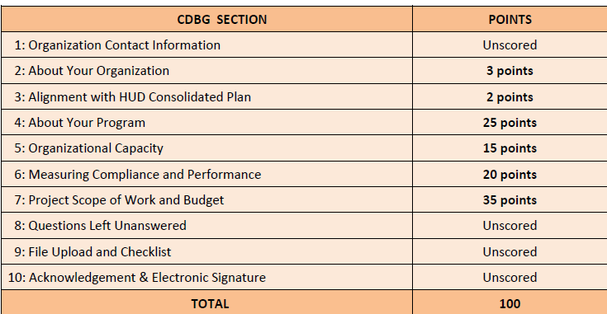
Application
Scoring
HOPWA SECTION | POINTS
Organization Contact Information | Unscored
1: About Your Organization | 5 points
2: HOPWA Funding Request | 5 points
3: About Your Program (using COH funding) | 25 points
4: Overall Performance Measurement | 20 points
5: Population, Needs, Demand | 15 points
6: Organization Capacity | 10 points
7: Partners, Leveraging, Sustainability | 10 points
8: Budget | 10 points
9: Attachment and Checklist | Unscored
10: Acknowledgement & Electronic Signature | Unscored
TOTAL | 100
ESG SECTION | POINTS
Organization Contact Information | Unscored
1: About Your Organization | 5 points
2: ESG Funding Request | 5 points
3: About Your Program (using COH funding) | 20 points
4: Collaboration/Coordination of Services | 10 points
5: Organizational Capacity | 15 points
6: Overall Performance Measurement | 20 points
7: Matching, Leveraging | 10 points
9: Budget and Justification | 15 points
9: Attachments and Checklist | Unscored
10: Acknowledgement & Electronic Signature | Unscored
TOTAL | 100
Notes:
Point out save

Slide 24
CDBG Application
Sections 1-3- Your Organization & HUD alignment
Information about your organization as a whole –mission , vision, focus, range
HUD alignment- how does the program you are asking the City to fund, fit into the Consolidated Plan priorities.

Slide 25
Application Process- Repeating Groups
Staff Contact Information
Staff Qualifications
Select a role then provide information for a key staff in that position *.
Repeated Groups:
Provide information for key staff in the roles listed.
Click on the Add button to add the same
fields for the next person in the same or new role.
The number of iterations is dependent on the number of your staff
When done click on Continue
(* In section 5 note the box to upload Staff resumes)

Slide 26
CDBG Application
Section 4 About the Program Requesting Funds
Goal is to streamline the application by pairing descriptions with data that tells us:
  Who you serve,- is that different for HUD funds ?
  Why you serve them
  Who you partner with
  How your program operates in time and space
  What makes it an effective program
For some questions your answers will trigger other questions

Slide 27
CDBG Application
Section 5 Program Capacity- Risk Assessment
Does the organization have the staffing and expertise to execute a Federal program and demonstrate results :
  Repeating information on skills and experience for each staff named.
  Does the organization have knowledge and experience about managing program grants, in particular Federal grants

Slide 28
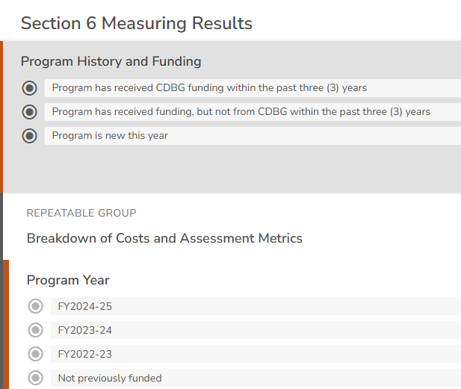
CDBG Application Process:
Section 6 Measuring Results
Select the category that best describes your program’s funding history
Answer the questions shown

Slide 29
CDBG Application Process:
Section 6 Measuring Results
To choose the category of funding:
1– If your program has received CDBG funds in any of the last three fiscal years (even if your program has received CDBG funds in only one or two of the last three fiscal years).
2– If you haven’t received CDBG funds in any of the last three fiscal years for the
program for which you are requesting funds, but other funding was acquired.
3– If your program (requesting CDBG funds) is a new program. Mention any information available about # served, months in operation, and the type of information you will be collecting and using to assess its progress and success..

Slide 30
CDBG Application Process:
Section 7 Program Request and Budget
Project Scope of Work
This section is formatted to resemble the awarded sub-recipient contract Scope of Work (SOW)
This is a repeated group. For each program activity your program engages in you will provide the following information:
  1. Describe the activity that recipients will participate in
  2. How are the activities implemented (e.g.. staff, resources, consultants)
  3. The product , result, expected outcome of the activity and how it will benefit the recipient and contribute to improving Hartford (National Objective)
After entering an activity, you can ADD others or CONTINUE to the next question.
Notes:
If you receive other funds for your program this should be reflected in the proportion of time staff contribute to the HUD funded portion- especially if you are charging for ED time, 1. can’t charge 100% of their time to the HUD grant 2. amounts should be in proportion to the time spent on the HUD funded portion of the grant.

Slide 31
CDBG Application Process:
Section 7 Program Request and Budget
There are two components of the budget:
  Revenue: Program Funding Sources Overall –The monies($) needed (Funding Request) and received ( Awarded/Secured) to operate the program for which you are seeking CDBG funds.
  Expenses: CDBG Request (Line Item Budget) – How you propose to use CDBG funds.
Notes:
If you receive other funds for your program this should be reflected in the proportion of time staff contribute to the HUD funded portion- especially if you are charging for ED time, 1. can’t charge 100% of their time to the HUD grant 2. amounts should be in proportion to the time spent on the HUD funded portion of the grant.

Slide 32
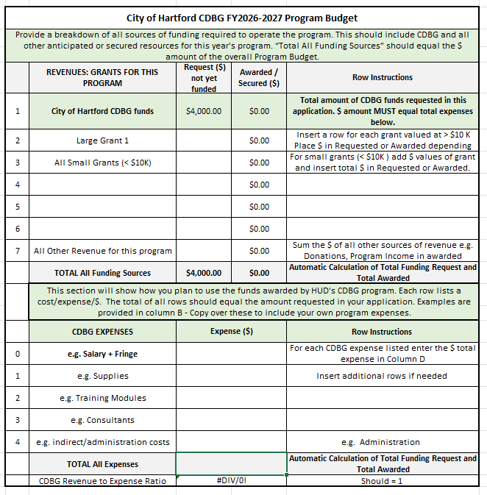

Enter your CDBG $ Request
CDBG BUDGET REVENUE
e.g., fees, endowment funds, etc.
Consider these as secured
and estimate the $

Slide 33
CDBG BUDGET
EXPENSES
In each line, list a separate budget category and accompanying expense estimate.
Cost to administer the program
Total CDBG request. Sums the budget lines included above.

Slide 34
CDBG Application Process:
Section 7 Program Request and Budget
Program Expenses- CDBG –Line-Item Budget-- Bottom section of form
  Breakdown of how you would spend CDBG funds.
  For example, if you are requesting $10,000 in CDBG funds, you must account for all $10,000 across up to five budget categories including: salary costs, fringe costs, supplies, etc.
  Be prepared to provide specifics on each of your expense categories.
  Use the Budget Narrative section in the on-line Application to describe why you are asking for each of these expenses including how you estimated each cost and how the cost will support your program.
  Looking for well-justified, reasonable expenses that contribute meaningfully to the successful operation of your CDBG program.

Slide 35
CDBG PROGRAM COMPLIANCE
If your organization is awarded a CDBG grant please be advised of the following compliance requirements for contracts.
All forms must be fully completed.

Slide 36
Proof of Applicant’s Insurance Coverage
Organizations awarded CDBG funds must be able to provide proof of insurance by submission of a certificate of insurance naming the City of Hartford as beneficiary and meeting all other requirements set forth in the application and City of Hartford contract.
The cost of the applicant’s insurance is not eligible for reimbursement with HUD entitlement funds (CDBG, HOPWA, ESG, or HOME).
Organizations must submit a compliant certificate of insurance as a condition of entry into a contract for funding with the City of Hartford. Maintenance of the certificate in full force throughout the term of the contract is a condition of continued funding availability.
A summary of the requirements for a compliant insurance certificate are in the application, and the applicant will be certifying in advance its agreement to maintain that insurance. Please review the requirements carefully before applying for CDBG funding.

Slide 37
Proof that Applicant is Current in Payment of City Taxes, Fees, Fines, and Other Revenue
As a condition of receipt of HUD funds, organizations awarded funds by the City of Hartford must be able to show they are current in the payment of City taxes and other revenue. The delinquency certificate attached to the CDBG, HOPWA, and ESG applications has been updated this year to include all forms of revenue.
Applicants do not need to visit the Tax Office. Only complete the contact information (first block). After you submit the application, we send the form to our internal department for verification. This process is performed when the application is received and if you are awarded funds, before
the applicant’s contract is approved.
Be aware that if your program is funded, no CDBG economic development program clients can be delinquent in the payment of any tax or other revenue to the City. Your program will not be reimbursed for expenses by these clients.

Slide 38
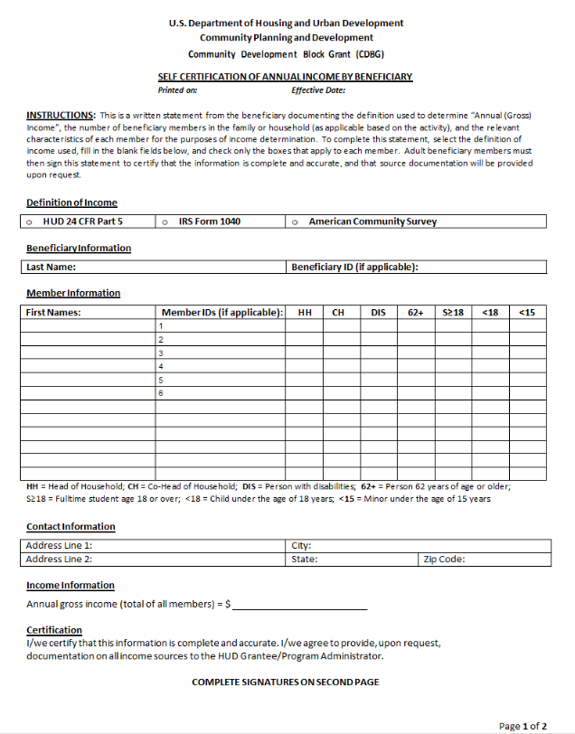
Program Operation/Required Form
CDBG Beneficiary Residency and Income Verification Form
  To be eligible for reimbursement of funds:
  Show evidence of Hartford residency for beneficiaries (or residency of a child’s parent).
  Self-certify household income to assess the proportion of LMI beneficiaries receiving benefit from CDBG

Slide 39
Program Operation/Required Form
CDBG Qualifying Criteria for Businesses Form
  Organizations requesting CDBG funds for economic development activities must provide the following for each individual (microenterprise) or business receiving assistance from an economic development provider:
o proof of residency and proof of low-or moderate-income for individuals receiving benefit from services supporting the development of a microenterprise;
o proof of business registration, compliance with city tax requirements, and a UEI number for each business or microenterprise receiving material services or benefits;
o proof of location of the subject business in the City of Hartford, or an affidavit from the participant;

Slide 40
Some Final Advice
Note that unanswered questions, missing attachments and/or certifications will influence your score, and may impact whether your application is considered
If you have problems with the website, or questions on the application – please contact us before the last day.
BE ON TIME: Deadline is February 27, 2026, at 11:59PM
•

Slide 41
Applications Next Steps :
Applications are grouped into categories by activity type (e.g. workforce development, economic development/job creation, neighborhood revitalization, youth programming, social services)
Panels discuss and evaluate proposals using objective scoring rubrics (e.g.eligibility ,soundness, relevance, history, likelihood of success)
Scored proposals are reviewed by the Mayor for recommendations
Recommendations are sent to City Council for final allocations.
  Public service – workforce development

Slide 42
Finally….
Questions?
Use the chat box

Slide 43

If you have questions please call, e-mail or schedule a one-on-one session.
(Get assistance with HOPWA and ESG grants)
Angelique Croasdale, Senior Project Manager, (860) 757-9277,
Angelique.Croasdale@hartford.gov
(Get assistance with CDBG grants)
Ronnie Vazquez, Project Manager, (860) 757-9284, Ronnie.Vazquez@hartford.gov
Any other questions:
Sheryl Horowitz, Director, (860) 757-9276, Sheryl.horowitz@hartford.gov
Thank you for attending!

