Slide 1
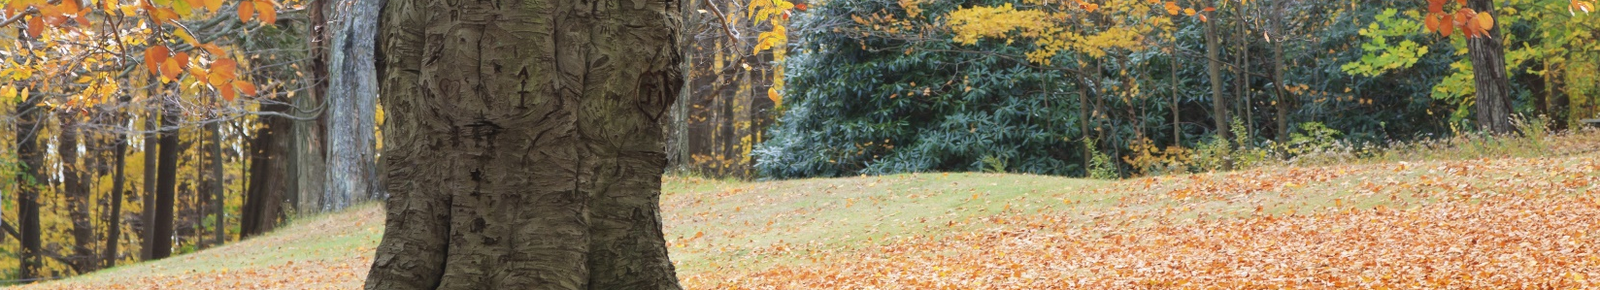


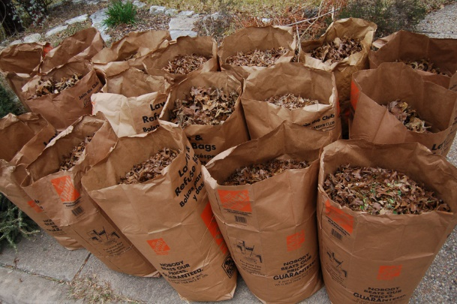
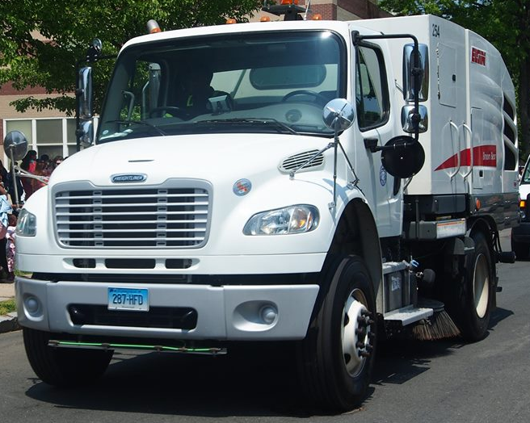

Street Services Division
CITY OF HARTFORD ● DEPARTMENT OF PUBLIC WORKS ● SPRING 2026
THE CITY OF HARTFORD WILL BE COLLECTING PAPER LEAF BAGS FOR A LIMITED TIME ONLY
CURBSIDE COLLECTION OF BROWN LEAF BAGS:
Curbside collection of LEAF BAGS will occur on normal trash days during the weeks of:
April 6th – 10th
April 13th – 17th
April 20th – 24th
THERE WILL BE NO CURBSIDE COLLECTION OF LOOSE LEAVES.
ADDITIONAL OPTION:
LEAF BAG DROPOFF:
Bring paper leaf bags to Waste & Recycling Center -
180 Leibert Road: Tuesday - Saturday, 8:45am – 1:45pm
BRANCHES & OTHER DEBRIS:
Tree limbs, branches and other brush debris, tied in 6 ft. sections, on normal trash days during the weeks of:
April 6th- 10th
April 13th – 17th
April 20th – 24th
For further information, Call Hartford 311 at 860-757-9311. Staff Available Monday – Friday: 8:00am – 5:00pm.

