Slide 1
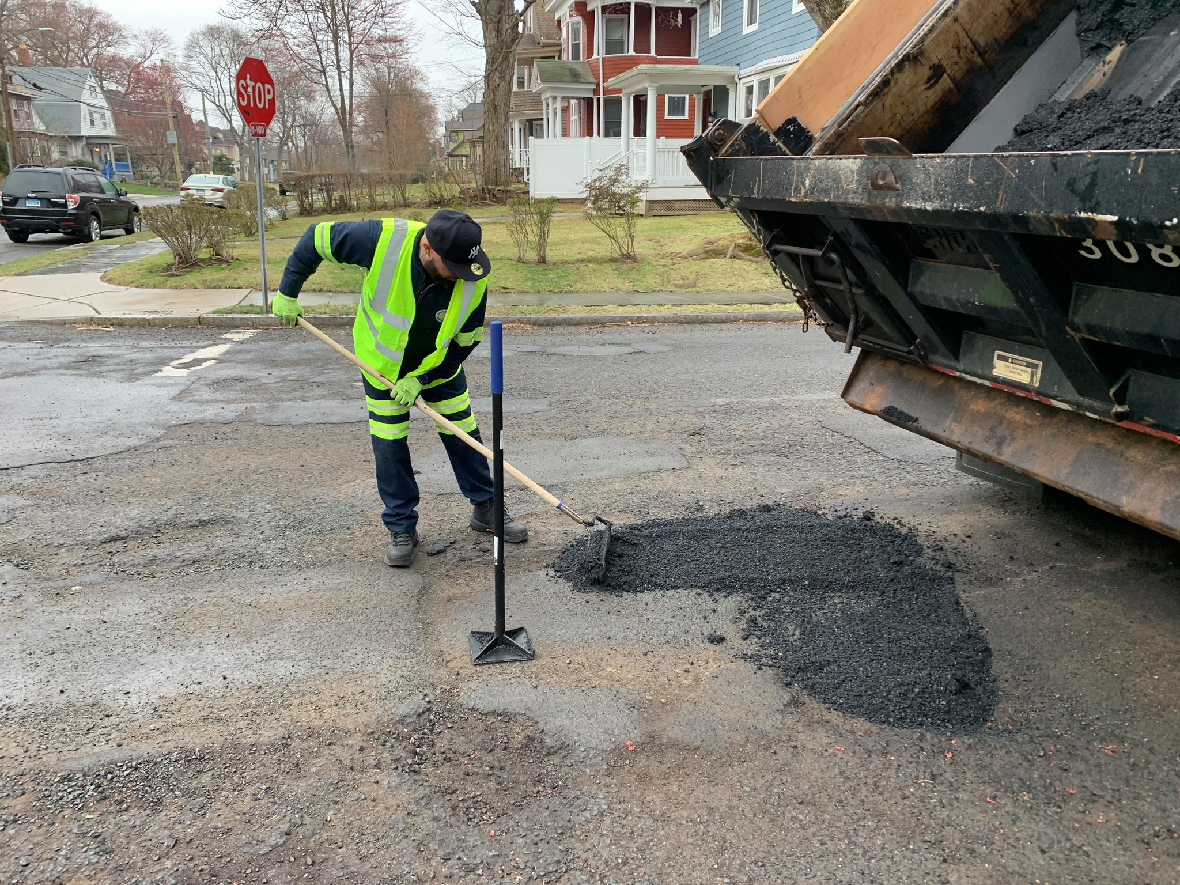

Streets Division
2025 NEIGHBORHOOD STREET REPAIR
The City of Hartford has identified the Streets for milling and paving for the 2025 construction season. The City has contracted with Rafferty Fine Grading and Galasso Paving to complete this work.
This is a notice to inform you that your street with be under construction starting
August 17th
Groupings, schedule and length of the project area will vary depending upon underlying road condition, weather conditions, traffic conditions, and coordination with utility companies regarding their repair schedules. Thank you for your patience and cooperation during this project.
Work will begin at 7:00 AM (M – F) and will finish around 5:00 PM. If you are within the active work zone limits and park your car in your driveway at night, please be sure to move it prior to the 7:00 AM start time, so you don’t get blocked by the construction. We understand that this may be a short-term inconvenience, but we hope this work will have a positive long-term impact in your neighborhood.
If you own underground facilities within a couple feet of the curb such as heated driveways, irrigation systems or underground dog fencing please contact us ASAP. Rafferty and Galasso cannot be responsible for damage to private utilities if they are unaware of their existence.
If you have any questions regarding this notice or the road construction project, feel free to contact Sebastian Tata, Traffic Engineer, Department of Public Works at 860-757-9959, or Melinda Johnson, Director of Community Engagement at 860-757-9525.

Slide 2
Streets Division
2025 NEIGHBORHOOD STREET REPAIR
2025 STREETS TO BE MILLED AND PAVED STARTING
American Row: Prospect St to State St Amity Street: Park St to Capitol Ave Baltic Street: Lebannon St to Coventry St Beacon Street: Capitol Ave to Prospect Ave Brandford Street: Palm St to Granby St Bristol Street: Newington Ave to Hollywood Ave Burnham St: Blue Hills Ave to Granby St Campfield Ave: South St to Victoria Rd Capitol Ave: Sisson Ave to Prospect Ave Central Row: Main St to Prospect St Chester Street: George St to Campfield Ave Colton St: Brandford St to Woodstock St Cromwell St: George St to Hubbard Rd Dorothy street: Park St to James St Ellsworth St: Crown St to New Britain Ave Freeman Street (1): Maple Ave to Fairfield Ave Freeman Street (2): Harvard St to Mountain St George St: Roosevelt St to Victoria Street Haddam St: Harvard St to Dead End Hartland St: Manchester St to Burnham St Harvard St: Manchester St to Burnham St Heath St: Park St to Capitol Ave James Street: Capitol Ave to Ashton St Julius St: New Britain Ave to Crown St Lebanon St: East Harold St to East Burnham St HOLD OFF UNTIL FALL: Chatham Street: Cornwall St to Granby St Cornwall Street: Granby St to Thomaston St | Litchfield St: Blue Hills Ave to Hartland St Lyme Street: Hebron St to Chatham St Manchester St: Cornwall to Blue Hills Ave Maple Ave: Franklin Ave to Bond St Market St: State St to Morgan St Mountford St: Henry St to Maple Ave Palm St: Burnham St to City Line Pembroke St: Granby St to Blue Hills Ave Roslyn St: New Britain Ave to Stafford St Sargeant St: Woodland St to Sigourney St Sharon Street: Granby St to Cornwall St Sprague St: Montrose St to Newington Ave Stafford St: Newington Ave to Hollywood Ave State St: Columbus St to Market St Townley St: Atwood St to Willard St Willard St: Asylum St to Dead End HOLD OFF UNTIL FALL: Hebron Street: Cornwall St to Granby St Lyme Street: Hebron St to Chatham St

Slide 3
División de Calles
REPARACION DE LAS CALLES EN SU VENCINDARIO 2025
La cuidad de Hartford ha identificado las calles para moliendar y pavimentar para la temporada de construccion de 2025. La Ciudad ha contratado a Rafferty Fine Grading y Galasso Paving para completar este trabajo.
Este es un aviso para informarle que su calle estará en construcción a partir del 10 de augusto.
Las agrupaciones, el horario y la longitud del área del proyecto variarán dependiendo del estado subyacente de la carretera, las condiciones meteorológicas, las condiciones de tráfico y la coordinación con las empresas de servicios públicos en relación con sus horarios de reparación. En algunas calles, el repavimenta miento no ocurrirá durante toda la longitud de la calle.
El trabajo comenzará a las 7:00 AM (lunes a viernes) y terminará alrededor de las 5:00 PM. Si usted está dentro de los límites de la zona de trabajo activa y aparca su coche en su camino de entrada por la noche, por favor asegúrese de moverla antes de las 7:00 AM hora de inicio, para que no se bloquee por la construcción. Entendemos que esto puede ser un inconveniente a corto plazo, pero esperamos que este trabajo tenga un impacto positivo a largo plazo en su vecindario. Si usted tienes instalaciones subterráneas dentro de un par de pies de la acera como caminos de entrada con calefacción, sistemas de riego o cercas subterráneas para perros, contáctenos lo antes posible. Rafferty y Galasso no pueden ser responsables de daños si desconocen su existencia.
Si tiene alguna pregunta con respecto a este aviso o al proyecto de construcción de la carretera, comuníquese con Sebastian Tata, Ingeniero de Tráfico, Departamento de Obras Públicas al 860-757-9959, o Melinda Johnson, Directora de Participación Comunitaria al 860-757-9525. Gracias por su paciencia y cooperación durante este proyecto.

Slide 4
División de Calles
REPARACION DE LAS CALLES EN SU VENCINDARIO 2025
Los trabajos de reparación se realizarán en las siguientes calles en 2025
American Row: Prospect St to State St Amity Street: Park St to Capitol Ave Baltic Street: Lebanon St to Coventry St Beacon Street: Capitol Ave to Prospect Ave Brandford Street: Palm St to Granby St Bristol Street: Newington Ave to Hollywood Ave Burnham St: Blue Hills Ave to Granby St Campfield Ave: South St to Victoria Rd Capitol Ave: Sisson Ave to Prospect Ave Central Row: Main St to Prospect St Chester Street: George St to Campfield Ave Colton St: Brandford St to Woodstock St Cromwell St: George St to Hubbard Rd Dorothy street: Park St to James St Ellsworth St: Crown St to New Britain Ave Freeman Street (1): Maple Ave to Fairfield Ave Freeman Street (2): Harvard St to Mountain St George St: Roosevelt St to Victoria Street Haddam St: Harvard St to Dead End Hartland St: Manchester St to Burnham St Harvard St: Manchester St to Burnham St Heath St: Park St to Capitol Ave James Street: Capitol Ave to Ashton St Julius St: New Britain Ave to Crown St Lebanon St: East Harold St to East Burnham St Esperar hasta el otoño: Chatham Street: Cornwall St to Granby St Cornwall Street: Granby St to Thomaston St | Litchfield St: Blue Hills Ave to Hartland St Lyme Street: Hebron St to Chatham St Manchester St: Cornwall to Blue Hills Ave Maple Ave: Franklin Ave to Bond St Market St: State St to Morgan St Mountford St: Henry St to Maple Ave Palm St: Burnham St to City Line Pembroke St: Granby St to Blue Hills Ave Roslyn St: New Britain Ave to Stafford St Sargeant St: Woodland St to Sigourney St Sharon Street: Granby St to Cornwall St Sprague St: Montrose St to Newington Ave Stafford St: Newington Ave to Hollywood Ave State St: Columbus St to Market St Townley St: Atwood St to Willard St Willard St: Asylum St to Dead End Esperar hasta el otoño: Hebron Street: Cornwall St to Granby St Lyme Street: Hebron St to Chatham St

