Slide 1
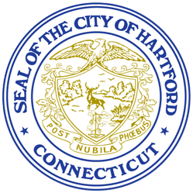


Facilitated through the
Office of Community Engagement
FUNDED BY

Slide 2
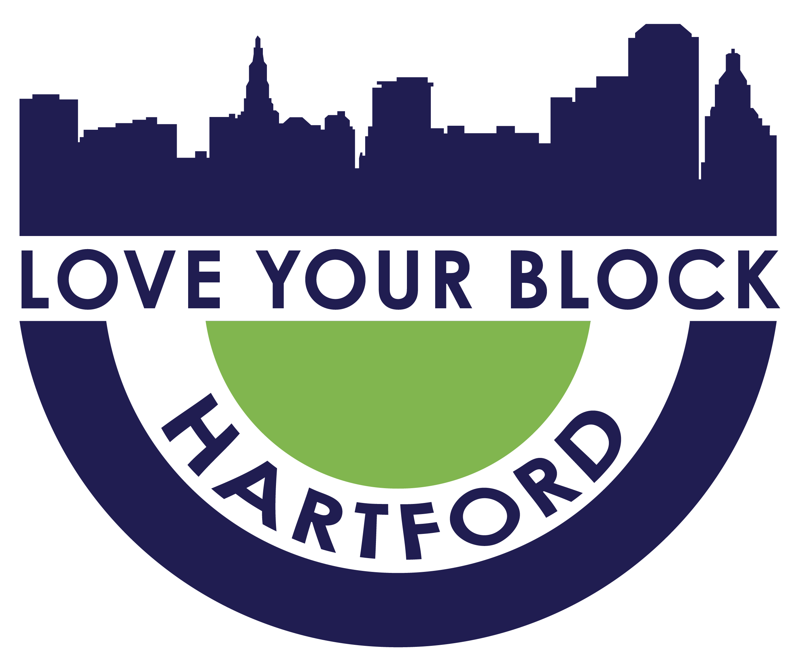
Grant Application Process Overview

Slide 3
What is Love Your Block?
  A partnership between the City, residents, neighborhood groups and local organizations
  A mini-grant program that supports residents and local organizations who have ideas on how to make a difference in their community
  A neighborhood beautification/quality of life improvement program
  An opportunity to see your ideas come to life

Slide 4
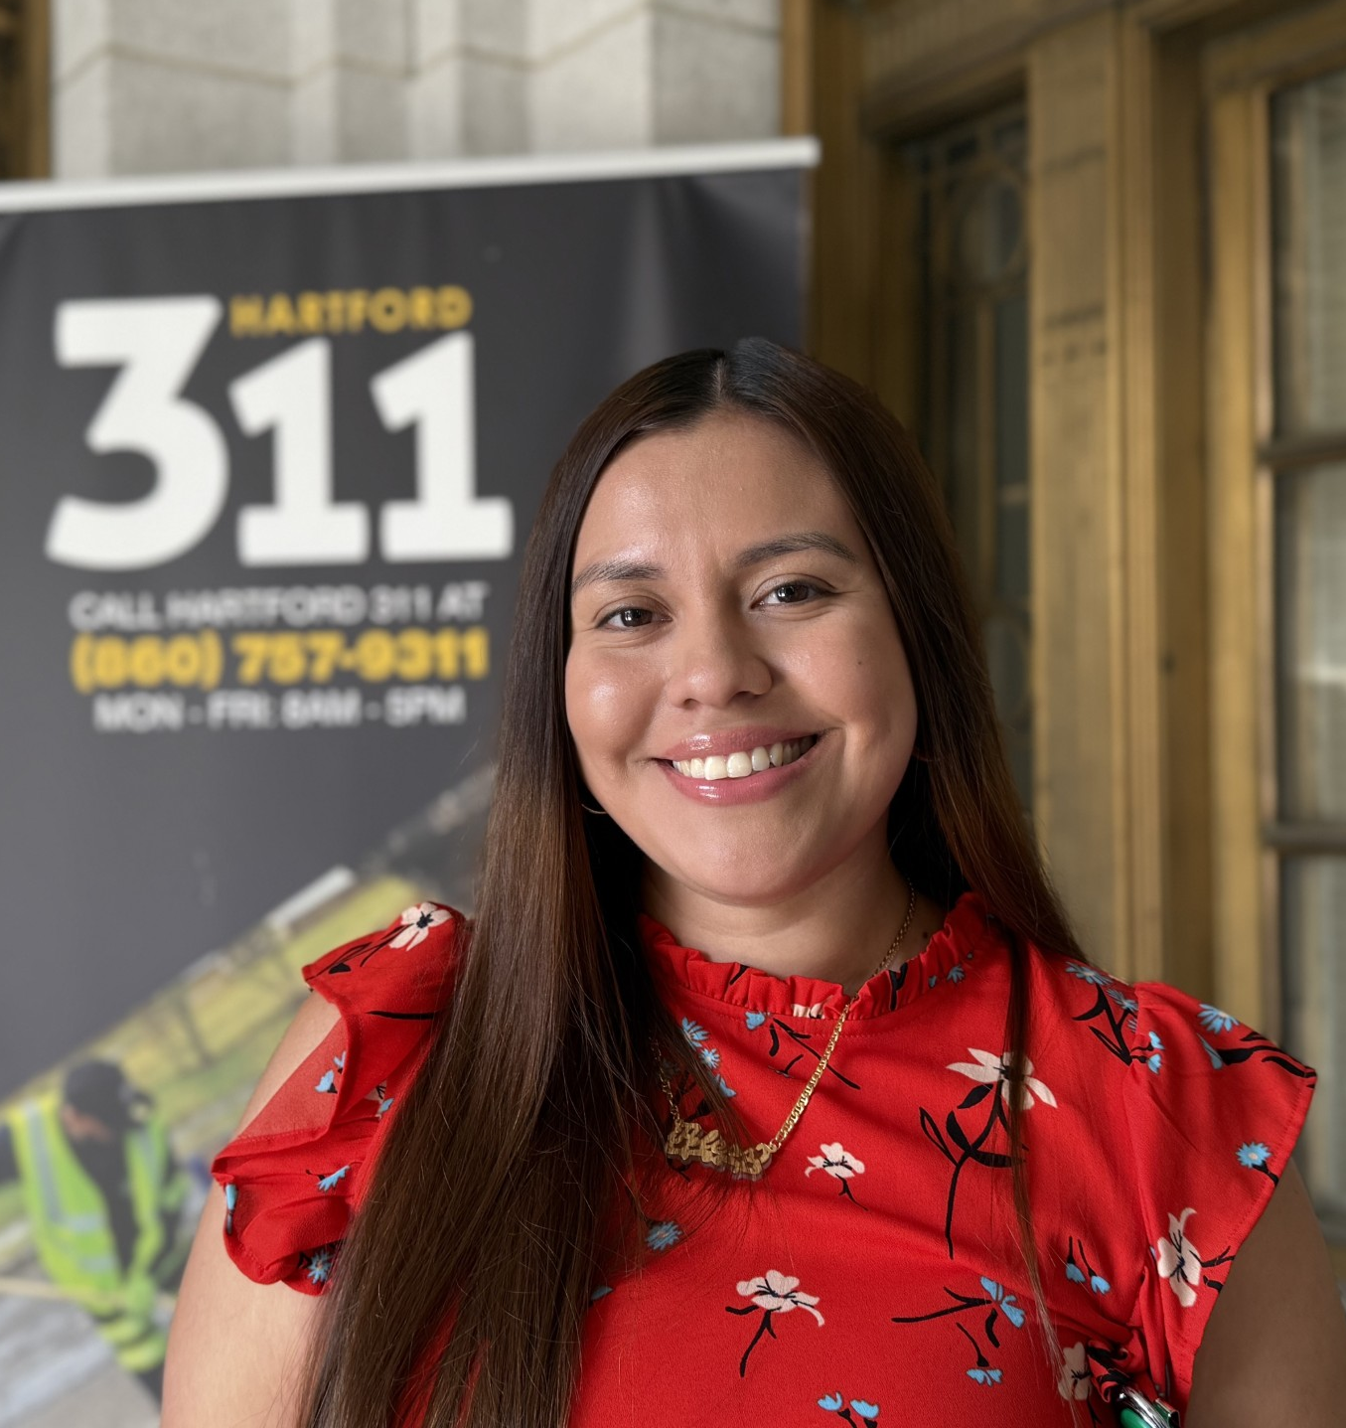
Your Support Team
Alessandra Ballestas
Manager
Office of the Mayor, Community Engagement
Email: loveyourblock@hartford.gov
Phone: (860) 757-9322

Slide 5
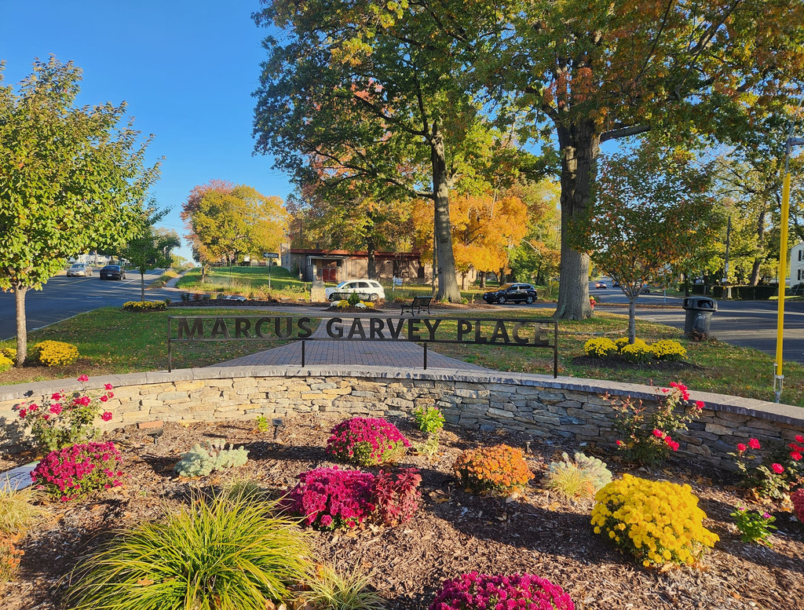
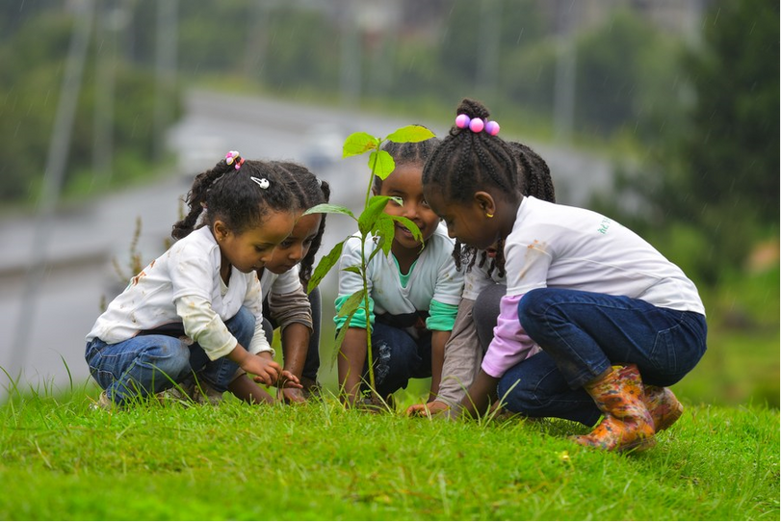
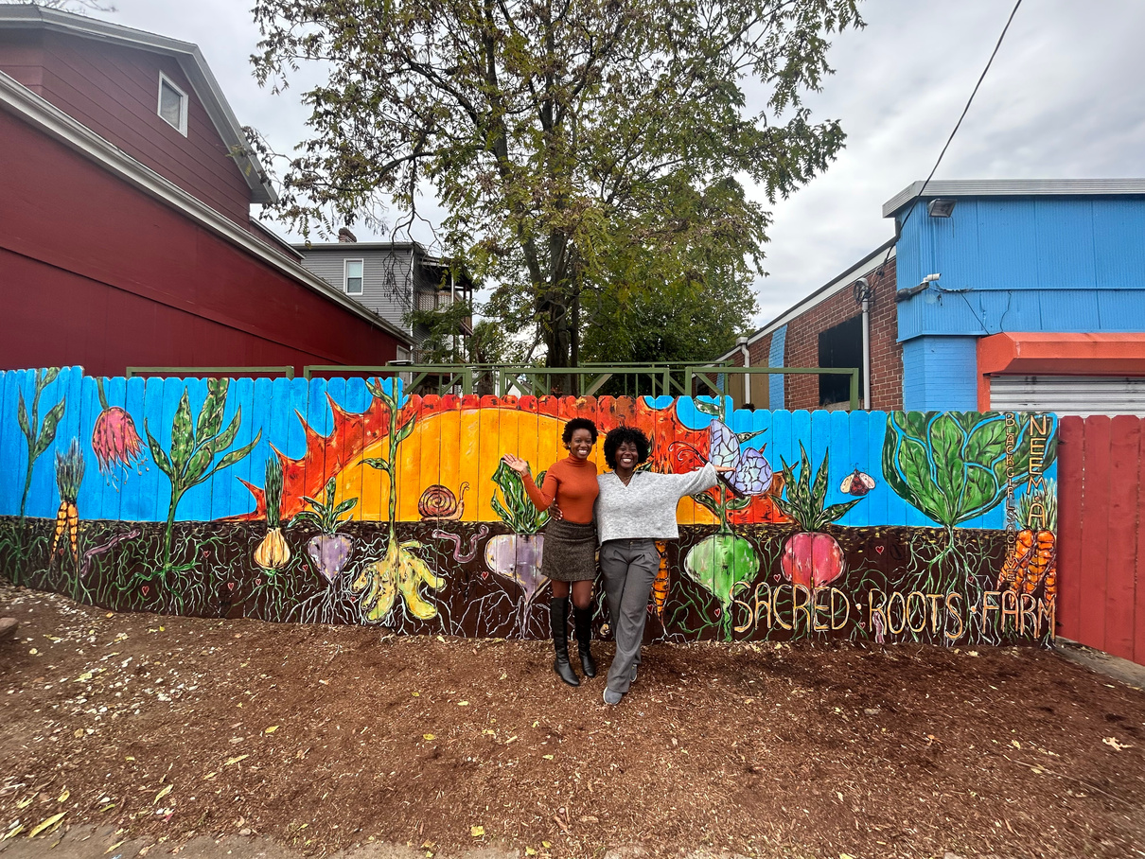
Project Categories
NEIGHBORHOOD PRIDE
  Community branding, including signage
  Community connections projects
  Neighborhood mural/art installation
  Repair or rehab of a public spaces
  Art instillations and demonstration that speak to Hartford’s History in recognition of America 250

Slide 6
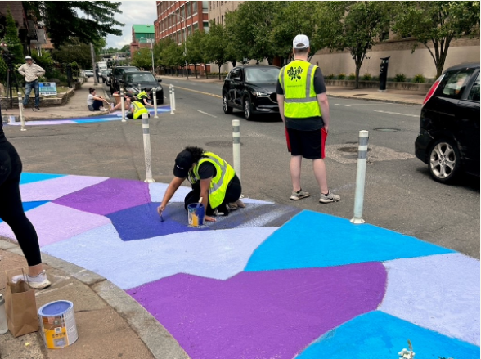
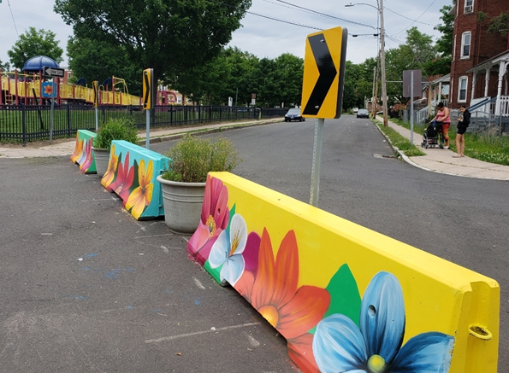
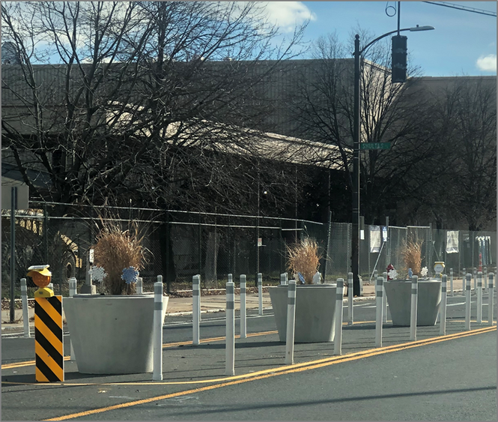
Project Categories
TRAFFIC CALMING
  Planters
  Street art
  Pedestrian safety quick builds

Slide 7
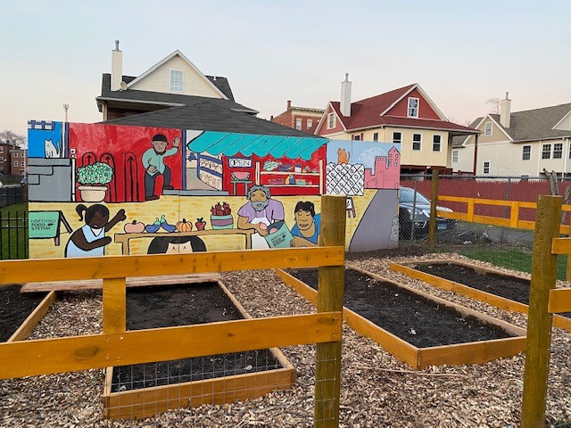
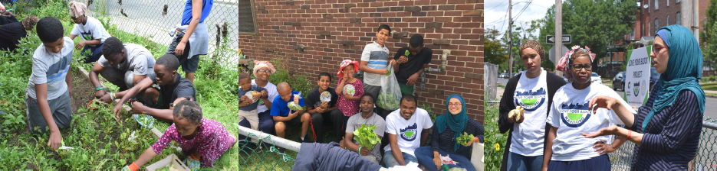
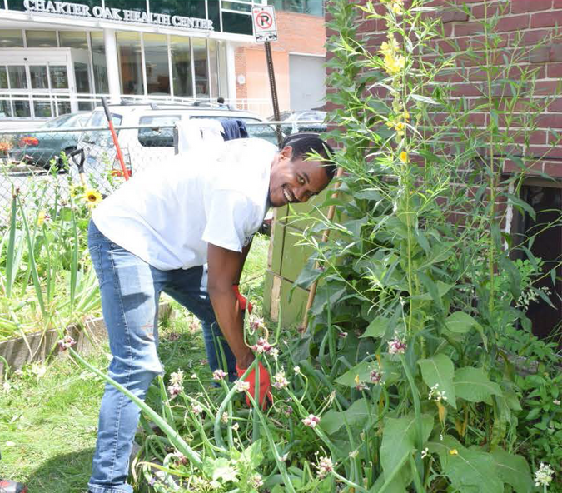
Project Categories
BLIGHT REDUCTION AND
ENVIRONMENTAL IMPROVEMENTS
  Vacant lot clean up and activation
  Community gardens
  Graffiti removal or art replacement
  Community clean ups
  Tree planting

Slide 8
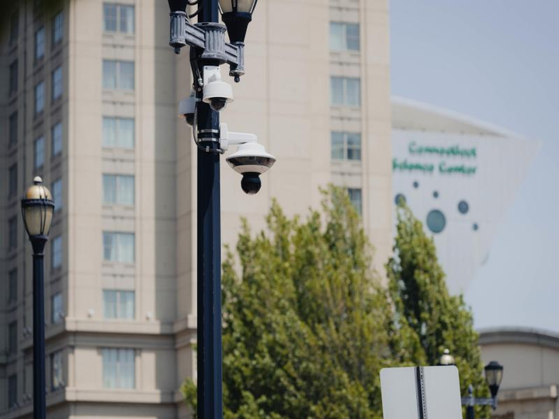
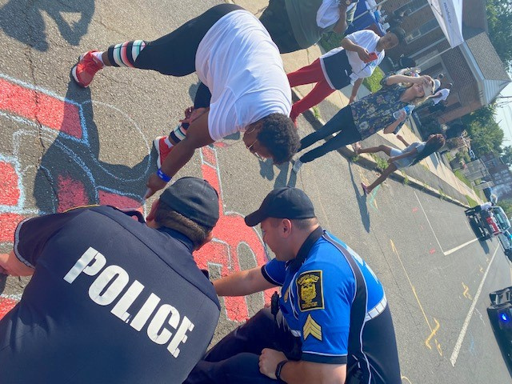
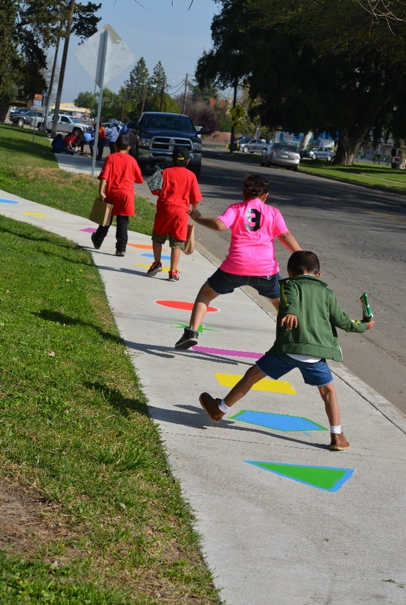
Project Categories
PUBLIC SAFETY
  Projects that connect residents to public safety officers
  Wayfinding signs
  String lighting
  Safe routes to school projects

Slide 9

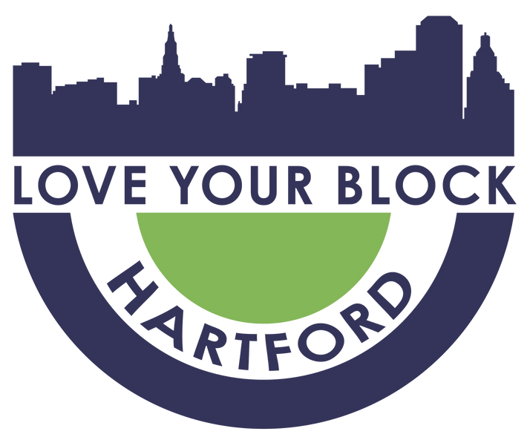
IT STARTS HERE...
INVITATION
FOR IDEAS

Slide 10
Big or Small Ideas
  How to submit?
    Complete the Simple Idea Form at www.hartfordct.gov/lybgrant starting March 2nd
  What's the Deadline?
    Ideas must be received by March 23, 2026
      Submitting your idea gives you the opportunity to have your idea vetted for feasibility and project alignment. Project found to be feasible and aligned will be invited to apply.

Slide 11
After Idea Submission
  Idea review period - projects must be approved and/or vetted by the City of Hartford prior to the invitation to apply– for instance, projects in public parks must be vetted by DPW, projects on private property require letter of permission. Approval guidance will be provided upon request.
  Feedback is provided to submissions that need small tweaks
  Invited to officially apply for grant opportunity - CANNOT SHARE LINK
LYB Resident Grant
LYB Community Grant
  Resident-led
  Project completed by October 2026
  Up to $3,000 in funding
  Application through City of Hartford
  Led by or informed by residents but with a nonprofit partner
  Up to $25,000 in funding
  Application through Greater Hartford Gives Foundation

Slide 12
The Application Process
Round 1: Idea Submission Period
March 2nd - Idea submission period begins
March 23rd - End of idea submission period
March 30th - Idea submissions review begins
Round 2: Invitations to Apply
April 6th - Grant submission period begins
May 4th - Application period ends
June - Grant Recipients Announced

Slide 13
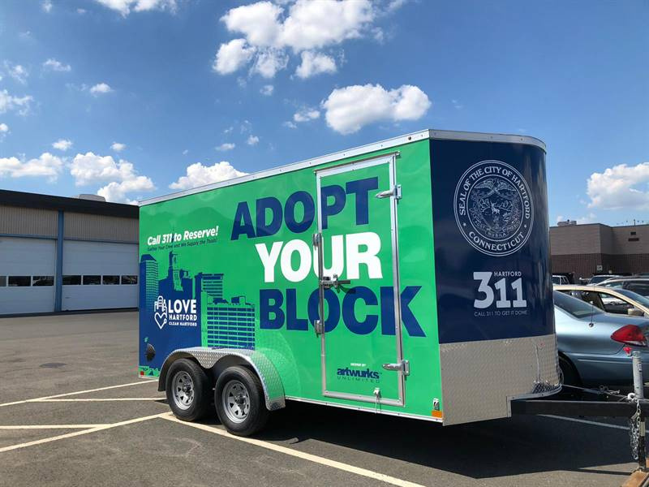
Project Support
The "Adopt Your Block" Trailer is an anti-litter tool lending library.
Visit www.hartfordct.gov/lybtrailer to see available tools and to reserve.

Slide 14
The Review Process
  Grant applications are reviewed and scored by community groups
    Project Proposal (25 points)
    Community Engagement (25 points)
    Budget (20 points)
    Metrics & Impact (10 points)
    Sustainability Plan (20 points)
  The recommended projects are submitted to Greater Hartford Gives Foundation for final approval

Slide 15
Project Selected...Now What
  We Celebrate!!
  Email notifications of grant award and next steps
  Press announcement in June
  Resident Grant Funds distributed by Hartford NEXT
  Community Grant Funds distributed by Greater Hartford Gives Foundation

Slide 16
Required Actions
PROJECT DOCUMENTATION
  Take Photos of before and after
  Record number of volunteers, bags of litter collected, number of events held.
  Funds distributed by early June
STAY IN TOUCH
  SHARE PROJECT UPDATES TO LOVEYOURBLOCK@HARTFORD.GOV
  Share upcoming events

Slide 17


QUESTIONS

Slide 18
THANK YOU!
Alessandra Ballestas
Community Engagement Manager,
Department of Public Works
550 Main Street
Hartford, CT 06103
Office: 860-757-9322
Email: Alessandra.Ballestas@hartford.gov

