Slide 1

City of Hartford
FIRE DEPARTMENT
FIRESTAT
April 2021

Slide 2


AGENDA
Introductions
Remark’s from Chief Barco
Remark’s from Chief Reilly
Division Briefings
Questions/Comments

Slide 3

Chief Reilly

Slide 4
Chief Barco

Slide 5
EMERGENCY SERVICES

Slide 6
2020 FireStat Updates
Suppression Only
  The ISO standard will be used to gauge the efficiency of fire suppression personnel to structure fires. A total time of six minutes and twenty seconds is allotted from time the alarm is received at Dispatch to the time the first Engine/Pumper company arrives.
  The NFPA 1710 for EMS will be used to gauge the efficiency of fire suppression personnel responding to EMS related incidents. 60 seconds is allotted for turnout time and 240 seconds are allotted for travel time.
  EMS runs are calculated using incident types 300 through 329, 510.

Slide 7

Fire Response Scorecard City-Wide |  | Operational Performance Measure: To measure the Response time of 4 firefighters or 1 Engine according ISO standards.
 |  | Data Source: Firehouse Software | Current Period: 04/01/2021 - 04/30/2021
HFD Strategic Priorities: Provide Quality Emergency Services |  | Performance Target: Arrival of 1 Engine in 6:20 minutes (ISO) 90% of time
Analysis
Exceeded the goal of 90% for this month. Significant more fire duty when compared to March of 2020.
Notes:
Changed Actual Fires to False Fire Alarms

Slide 8
+
EMS Response Scorecard City-Wide |  | Operational Performance Measure: To measure the Response to EMS incidents City-wide.
 |  | Data Source: Firehouse Software | Current Period: 04/01/2021 - 04/30/2021
HFD Strategic Priorities: Provide Quality Emergency Services |  | Performance Target: Arrival of 5 minutes or less for First Responder calls - National Standard 1710 is at 90%.
Analysis | Recommendations |  |  | Impact
Good improvement of response time compliance. | Continue to emphasize the importance of responding to EMS per our standard. |  |  | Sustainment of efficient EMS delivery which allows us as a department to have a positive impact on patient survivability.

Slide 9
Fire Response Scorecard District 1 |  | Operational Performance Measure: To measure the Response time of 4 firefighters or 1 Engine according ISO standards.
 |  | Data Source: Firehouse Software | Current Period: 04/01/2021 - 04/30/2021
HFD Strategic Priorities: Provide Quality Emergency Services |  | Performance Target: Arrival of 1 Engine in 6:20 minutes (ISO) 90% of time
Analysis | Recommendations |  |  | Impact
Excellent work. | Continue to reiterate the importance of response time compliance. |  |  | Life safety stabilization
Notes:
Changed Actual Fires to False Fire Alarms

Slide 10
+
EMS Response Scorecard District 1 |  | Operational Performance Measure: To measure the Response to EMS incidents City-wide.
 |  | Data Source: Firehouse Software | Current Period: 04/01/2021 - 04/30/2021
HFD Strategic Priorities: Provide Quality Emergency Services |  | Performance Target: Arrival of 5 minutes or less for First Responder calls - National Standard 1710 is at 90%.
Analysis | Recommendations |  |  | Impact
Good improvement when compared to the prior month. | Continue to re-emphasize importance of EMS responses to members of suppression. |  |  | Sustainment of efficient EMS delivery which allows us as a department to have a positive impact on patient survivability.

Slide 11
Fire Response Scorecard District 2 |  | Operational Performance Measure: To measure the Response time of 4 firefighters or 1 Engine according ISO standards.
 |  | Data Source: Firehouse Software | Current Period: 04/01/2021 - 04/30/2021
HFD Strategic Priorities: Provide Quality Emergency Services |  | Performance Target: Arrival of 1 Engine in 6:20 minutes (ISO) 90% of time
Analysis | Recommendations |  |  | Impact
Excellent work by District 2. | Maintain proficiency. |  |  | Effective emergency response.
Notes:
Changed Actual Fires to False Fire Alarms

Slide 12
+
EMS Response Scorecard District 2 |  | Operational Performance Measure: To measure the Response to EMS incidents City-wide.
 |  | Data Source: Firehouse Software | Current Period: 04/01/2021 - 04/30/2021
HFD Strategic Priorities: Provide Quality Emergency Services |  | Performance Target: Arrival of 5 minutes or less for First Responder calls - National Standard 1710 is at 90%.
Analysis | Recommendations |  |  | Impact
Good improvement when compared to the prior month. | Continue to re-emphasize importance of EMS responses to members of suppression. |  |  | Sustainment of efficient EMS delivery which allows us as a department to have a positive impact on patient survivability.

Slide 13
Fire Response Scorecard Tour A |  | Operational Performance Measure: To measure the Response time of 4 firefighters or 1 Engine according ISO standards.
 |  | Data Source: Firehouse Software | Current Period: 04/01/2021 - 04/30/2021
HFD Strategic Priorities: Provide Quality Emergency Services |  | Performance Target: Arrival of 1 Engine in 6:20 minutes (ISO) 90% of time
Analysis | Recommendations |  |  | Impact
Outstanding job, Tour A. Phenomenal job with consistently obtaining goal. 7 consecutive months of 100% compliance! Excellent work. | Reiterate the importance of safely responding to calls for service in the allotted time period. |  |  | Effective emergency response.
Notes:
Changed Actual Fires to False Fire Alarms

Slide 14
+
EMS Response Scorecard Tour A |  | Operational Performance Measure: To measure the Response to EMS incidents City-wide.
 |  | Data Source: Firehouse Software | Current Period: 04/01/2021 - 04/30/2021
HFD Strategic Priorities: Provide Quality Emergency Services |  | Performance Target: Arrival of 5 minutes or less for First Responder calls - National Standard 1710 is at 90%.
Analysis | Recommendations |  |  | Impact
Inclement weather played a part in the response time average. | Continue to re-emphasize importance of EMS responses to members of suppression. |  |  | Sustainment of efficient EMS delivery which allows us as a department to have a positive impact on patient survivability.

Slide 15
Fire Response Scorecard Tour B |  | Operational Performance Measure: To measure the Response time of 4 firefighters or 1 Engine according ISO standards.
 |  | Data Source: Firehouse Software | Current Period: 04/01/2021 - 04/30/2021
HFD Strategic Priorities: Provide Quality Emergency Services |  | Performance Target: Arrival of 1 Engine in 6:20 minutes (ISO) 90% of time
Analysis | Recommendations |  |  | Impact
Outstanding job, Tour B. Compliance performance is exceptional. | Maintain efficiency. |  |  | Effective emergency response.
Notes:
Changed Actual Fires to False Fire Alarms

Slide 16
+
EMS Response Scorecard Tour B |  | Operational Performance Measure: To measure the Response to EMS incidents City-wide.
 |  | Data Source: Firehouse Software | Current Period: 04/01/2021 - 04/30/2021
HFD Strategic Priorities: Provide Quality Emergency Services |  | Performance Target: Arrival of 5 minutes or less for First Responder calls - National Standard 1710 is at 90%.
Analysis | Recommendations |  |  | Impact
Inclement weather played a part in the response time average. | Continue to re-emphasize importance of EMS responses to members of suppression. |  |  | Sustainment of efficient EMS delivery which allows us as a department to have a positive impact on patient survivability.

Slide 17
Fire Response Scorecard Tour C |  | Operational Performance Measure: To measure the Response time of 4 firefighters or 1 Engine according ISO standards.
 |  | Data Source: Firehouse Software | Current Period: 04/01/2021 - 04/30/2021
HFD Strategic Priorities: Provide Quality Emergency Services |  | Performance Target: Arrival of 1 Engine in 6:20 minutes (ISO) 90% of time
Analysis | Recommendations |  |  | Impact
Outstanding job, Tour C. | Reiterate the continued expectation of compliance. |  |  | Efficiency of emergency response.
Notes:
Changed Actual Fires to False Fire Alarms

Slide 18
+
EMS Response Scorecard Tour C |  | Operational Performance Measure: To measure the Response to EMS incidents City-wide.
 |  | Data Source: Firehouse Software | Current Period: 04/01/2021 - 04/30/2021
HFD Strategic Priorities: Provide Quality Emergency Services |  | Performance Target: Arrival of 5 minutes or less for First Responder calls - National Standard 1710 is at 90%.
Analysis | Recommendations |  |  | Impact
Excellent effort by Tour C. | Continue to re-emphasize importance of EMS responses to members of suppression. |  |  | Sustainment of efficient EMS delivery which allows us as a department to have a positive impact on patient survivability.

Slide 19
Fire Response Scorecard Tour D |  | Operational Performance Measure: To measure the Response time of 4 firefighters or 1 Engine according ISO standards.
 |  | Data Source: Firehouse Software | Current Period: 04/01/2021 - 04/30/2021
HFD Strategic Priorities: Provide Quality Emergency Services |  | Performance Target: Arrival of 1 Engine in 6:20 minutes (ISO) 90% of time
Analysis | Recommendations |  |  | Impact
Met performance goal with 100% compliance for the month of March (twice in a row). | Sustain excellent emergency responses. |  |  | Life safety incident stabilization.
Notes:
Changed Actual Fires to False Fire Alarms

Slide 20
+
EMS Response Scorecard Tour D |  | Operational Performance Measure: To measure the Response to EMS incidents City-wide.
 |  | Data Source: Firehouse Software | Current Period: 04/01/2021 - 04/30/2021
HFD Strategic Priorities: Provide Quality Emergency Services |  | Performance Target: Arrival of 5 minutes or less for First Responder calls - National Standard 1710 is at 90%.
Analysis | Recommendations |  |  | Impact
Solid improvement when compared to February’s performance. | Continue to reiterate the importance of compliance. |  |  | Sustainment of efficient EMS delivery which allows us as a department to have a positive impact on patient survivability.

Slide 21
COMMUNITY RISK REDUCTION – FIRE MARSHAL OFFICE

Slide 22
Performance Scorecard Community Risk Reduction Division -FM |  |  |  | Operational Performance Measure: Efficient Deployment of resources to support code enforcement and fire prevention initiatives that reduce avoidable incidents.
HFD Strategic Priorities: Provide Quality Code enforcement |  |  |  | Performance Target – Risk in the community are minimized through a proactive code enforcement and public education program, respectively.
Data Source: HFD Firehouse Software
Current Period: 04/01/2021 - 04/30/2021
HISTORICAL ANALYSIS
Reporting Period | Violations
 | Violations Found | Violations Cleared
11/20 | 61 | 69
12/20 | 122 | 177
01/21 | 381 | 21
02/21 | 84 | 91
03/21 | 407 | 270
04/21 | 210 | 159
Attendance |  |  |  | Recommendations | Impact
 |  |  |  | **THIRD REQUEST** Forward a report to the fire chief’s office pertaining to what inspections were supposed to be done in 2020 versus what inspections actually did get done which should include a plan on how inspections will be conducted in 2021. 90% of time is not accounted. | Reduction of risks in the community as it pertains to our external stakeholders.
Total Working Hours: | 1,179.05 | Total Hours Off: | 840
Total Hours on Duty: | 1,385.25 | Hours Accounted For: | 85.11%
Notes:
Completed 0416

Slide 23
Performance Scorecard Community Risk Reduction Division -FM | Operational Performance Measure: Decrease avoidable incidents within the City of Hartford.
 | Data Source: Firehouse Software | Current Period: 04/01/2021 - 04/30/2021
HFD Strategic Priorities: Provide Quality Code Enforcement, Public Education, & Community Engagement | Performance Target – Show a 30% decrease in fires by end of FY2021.
Analysis | Recommendations |  | Impact
Unintentional fires were high again for March of 2021 as they were in March of 2020. Intentional fires are down in comparison to 2019 & 2020. | Assess effectiveness of community risk reduction program. |  | Minimization of conflagrations in all parts of the city that are adversely impacted.
Notes:
Completed 0416

Slide 24
COMMUNITY RISK REDUCTION – SPECIAL SERVICES UNIT

Slide 25
Performance Scorecard Community Risk Reduction Division -SSU |  |  |  | Operational Performance Measure: Decrease avoidable incidents within the City of Hartford.
HFD Strategic Priorities: Provide Public Education, & Community Engagement |  |  |  | Performance Target – Reduction in Residential Structure Fires by 20% by 1st Quarter 2021.
Data Source: HFD Firehouse Software
Current Period: 04/01/2021 - 04/30/2021
HISTORICAL ANALYSIS
Reporting Period | 02/21 | 03/21 | 04/21
Total Activities | 121 | 116 | 133
Total Adults | 215 | 483 | 958
Total Children | 182 | 161 | 261
Smoke Detector | 3 | 4 | 0
Car Seats | 3 | 2 | 4
Attendance |  |  |  | Recommendations | Impact
 |  |  |  | Excellent community engagement and work in the firehouses. | Community is receiving adequate public fire & life safety education. Partnership with FMO has to be enhanced.
Total Working Hours: | 388 | Total Hours Off: | 10
Total Hours on Duty: | 401.5 | Hours Accounted For: | 96.64%
Notes:
Completed 0416

Slide 26
TRAINING DIVISON

Slide 27
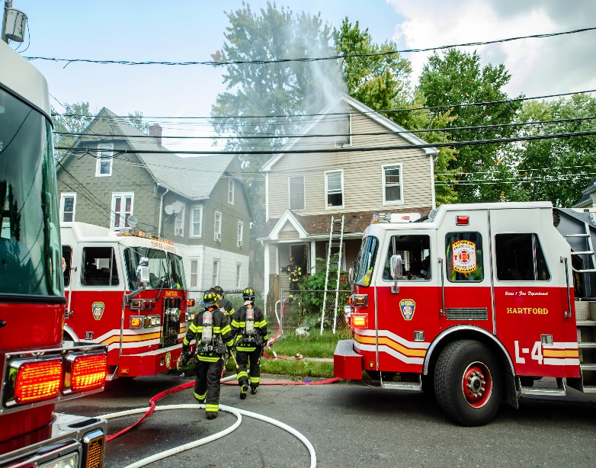
Performance Scorecard Training Division |  |  | Operational Performance Measure: Internal / External Stakeholder Engagement – Increase public /personnel awareness about the City of Hartford Fire Department.
HFD Strategic Priorities: Provide Mandated Training to Hartford Fire Department Personnel |  |  | Performance Target – Adequately train members of the HFD in proficiency topics that assist with sharpening knowledge, skills, and abilities.
Data Source: HFD Firehouse Software
Current Period: 04/01/2021 – 04/30/2021
HISTORICAL ANALYSIS
Attendance |  |  | Recommendations | Impact
 |  |  | Outstanding work by our Training Division personnel. Job well done. Time accounted for should not exceed 100%. | Workforce that is compliant with ISO and CONOSHA requirements.
Total Working Hours: | 1153.14 | Total Hours Off: | 260
Total Hours on Duty: | 1152 | Hours Accounted For: | 100.10%
Notes:
Completed 0416

Slide 28
EQUIPMENT MAINTENANCE DIVISION

Slide 29
Performance Scorecard Equipment Maintenance Division |  |  |  |  | Operational Performance Measure: Internal / External Stakeholder Engagement – Increase public /personnel awareness about the City of Hartford Fire Department.
 |  |  |  |  | Data Source: HFD Firehouse Software | Current Period: 04/01/2021 – 04/30/2021
HFD Strategic Priorities: Provide Quality & Timely Equipment Maintenance to All Apparatus/Equipment |  |  |  |  | Performance Target – Respond in a timely manner when sequestered by ESD/Support Services.
Data Source: HFD Firehouse Software
Current Period: 04/01/2021 – 04/30/2021
HISTORICAL ANALYSIS
Reporting Period
 | Hose Testing | Aerial Testing | Ground Ladder Testing | Fit Test
07/19 | 0 | 4 | 0 | 0
08/19 | 0 | 0 | 0 | 0
09/19 | 0 | 0 | 0 | 0
10/19 | 0 | 0 | 0 | 0
11/19 | 0 | 0 | 0 | 0
 |  |  |  |  | Recommendations |  | Impact
 |  |  |  |  | Strong work from EMD. Send report on out of service hours to the Office of the Chief. 90% of time must be accounted for. |  | Safe repair and maintenance of fire department tools, equipment, and apparatus.
Attendance
Total Working Hours: | 973 | Total Hours Off: | 280
Total Hours on Duty: | 1,159.50 | Hours Accounted For: | 83.92%
Notes:
Just needs fuel and OOS 04/08/2020

Slide 30
F.A.C.T. DIVISION

Slide 31
Performance Scorecard F.A.C.T. Division |  |  |  |  |  | Operational Performance Measure: Internal / External Stakeholder Engagement – Increase public /personnel awareness about the City of Hartford Fire Department.
HFD Strategic Priorities: Provide Quality I.T. & Technical Assistance to HFD |  |  |  |  |  | Performance Target – Mitigate a diverse portfolio of service calls.
Data Source: HFD Firehouse Software
Current Period: 04/01/2021 – 04/30/2021
HISTORICAL ANALYSIS
Reporting Period
 | Traffic | Comm & Tech | Training / Misc | Fire Alarm
11/20 | 12 | 0 | 3 | 11
12/20 | 24 | 4 | 2 | 7
01/21 | 45 | 13 | 33 | 37
02/21 | 83 | 29 | 21 | 48
03/21 | 76 | 25 | 8 | 70
Attendance |  |  |  |  |  | Recommendations | Impact
 |  |  |  |  |  | Excellent overall work. 90% of time must be accounted for. Consecutive months of non-compliance. Address the problem. | IS&IT execution of relevant duties and responsibilities.
Total Working Hours: | 633.5 | Total Hours Off: | 80
Total Hours on Duty: | 681.5 | Hours Accounted For: | 92.96%
Notes:
Completed 0416

Slide 32
EMERGENCY RESPONSE DATA

Slide 33

EMS
April 2021
Incident Type | Description | Count
321 | EMS call, excluding vehicle accident with injury | 956
311 | Medical assist, assist EMS crew | 357
324 | Motor Vehicle Accident with no injuries | 96
322 | Motor vehicle accident with injuries | 85
381 | Rescue or EMS standby | 75
510 | Person in distress, Other | 38
300 | Rescue, EMS incident, other | 13
323 | Motor vehicle/pedestrian accident (MV Ped) | 4
Notes:
Completed 0416

Slide 34
Rescue Calls
April 2021
Incident Type | Description | Count
511 | Lock-out | 7
352 | Extrication of victim(s) from vehicle | 5
353 | Removal of victim(s) from stalled elevator | 3
331 | Lock-in (if lock out , use 511 ) | 1
Notes:
Complete 0416

Slide 35
Narcan Administered
April 2021

Slide 36
Hazardous Materials
April 2021
Incident Type | Description | Count
412 | Gas leak (natural gas or LPG) | 7
463 | Vehicle accident, general cleanup | 3
400 | Hazardous condition, Other | 3
413 | Oil or other combustible liquid spill | 2
411 | Gasoline or other flammable liquid spill | 2
410 | Combustible/flammable gas/liquid condition, other | 1

Slide 37
All Fires
April 2021
Incident Type | Description | Count
131 | Passenger vehicle fire | 13
111 | Building fire | 11
142 | Brush or brush-and-grass mixture fire | 7
140 | Natural vegetation fire, Other | 4
154 | Dumpster or other outside trash receptacle fire | 4
113 | Cooking fire, confined to container | 4
141 | Forest, woods or wildland fire | 3
118 | Trash or rubbish fire, contained | 3
150 | Outside rubbish fire, Other | 3
151 | Outside rubbish, trash or waste fire | 3
117 | Commercial Compactor fire, confined to rubbish | 1
138 | Off-road vehicle or heavy equipment fire | 1
116 | Fuel burner/boiler malfunction, fire confined | 1
130 | Mobile property (vehicle) fire, Other | 1
112 | Fires in structure other than in a building | 1
481 | Attempt to burn | 1
100 | Fire, Other | 1
Notes:
Complete 0416

Slide 38
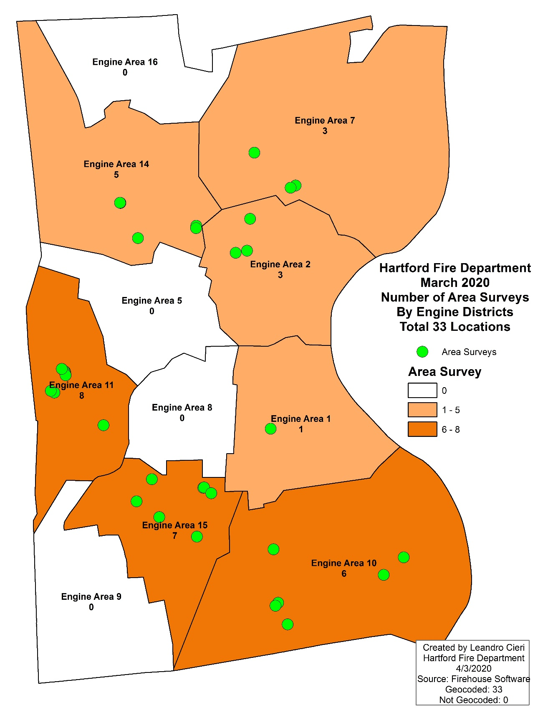

Area Survey
March 2020
Notes:
Completed 0416

Slide 39
Service Calls
April 2021
Incident Type | Description | Count
500 | Service Call, other | 130
552 | Police matter | 66
553 | Public service | 44
531 | Smoke or odor removal | 36
444 | Power line down | 14
554 | Assist invalid | 8
520 | Water problem, Other | 8
550 | Public service assistance, Other | 4
445 | Arcing, shorted electrical equipment | 3
571 | Cover assignment, standby, moveup | 2
441 | Heat from short circuit (wiring), defective/worn | 2
555 | Defective elevator, no occupants | 2
440 | Electrical wiring/equipment problem, Other | 2
442 | Overheated motor | 2
522 | Water or steam leak | 2
521 | Water evacuation | 1
551 | Assist police or other governmental agency | 1

Slide 40
Fire Alarms
April 2021
Incident Type | Description | Count
745 | Alarm system activation, no fire - unintentional | 73
743 | Smoke detector activation, no fire - unintentional | 18
740 | Unintentional transmission of alarm, Other | 17
735 | Alarm system sounded due to malfunction | 14
700 | False alarm or false call, Other | 8
710 | Malicious, mischievous false call, Other | 4
744 | Detector activation, no fire - unintentional | 3
715 | Local alarm system, malicious false alarm | 2
733 | Smoke detector activation due to malfunction | 2
730 | System malfunction, Other | 1
731 | Sprinkler activation due to malfunction | 1
746 | Carbon monoxide detector activation, no CO | 1
721 | Bomb scare - no bomb | 1
734 | Heat detector activation due to malfunction | 1

Slide 41
Undefined Calls
April 2021
Incident Type | Description | Count
622 | No Incident found on arrival at dispatch address | 201
661 | EMS call, party transported by non-fire agency | 8
611 | Dispatched & cancelled en route | 2
621 | Wrong location | 1
900 | Special type of incident, Other | 1
653 | Smoke from barbecue, tar kettle | 1
651 | Smoke scare, odor of smoke | 1

Slide 42
Key | Incident Number | Response | Firefighter Fatality | Firefighter Injury | Civilian Fatality | Civilians Injured | Cause
0 | 0:03:30 | 21-0096045 | 0 | 0 | 0 | 0 | Undetermined
1 | 0:03:17 | 21-0099037 | 0 | 0 | 0 | 0
2 | 0:04:10 | 21-0101039 | 0 | 0 | 0 | 0 | Undetermined
3 | 0:04:21 | 21-0102063 | 0 | 0 | 0 | 0 | Candle
4 | 0:03:57 | 21-0106013 | 0 | 0 | 0 | 0
5 | 0:04:21 | 21-0108039 | 0 | 0 | 0 | 0 | Hot or smoldering object, Other
6 | 0:03:00 | 21-0108068 | 0 | 0 | 0 | 0 | Undetermined
7 | 0:04:11 | 21-0114023 | 0 | 0 | 0 | 0 | Undetermined
8 | 0:03:12 | 21-0114028 | 0 | 0 | 0 | 0
9 | 0:02:50 | 21-0114060 | 0 | 0 | 0 | 0
10 | 0:02:45 | 21-0116018 | 0 | 0 | 0 | 0

Slide 43
QUESTIONS/COMMENTS

